Slide 1
DDJ-1000SRT specific instructions for the Traktor mapping:
Please use the specific TSI for the DDJ-1000SRT. This is the same mapping as the DDJ-SZ mapping, but with small customizations to make it work well on the SRT:
Jog screens are NOT supported. This is because they are not documented on the Pioneer MIDI map file
Please put your jog weight to “heavy”
This will significantly improve scratching and jogFX
Audio device in external mode.
This means that ALL the pioneer effects (both colorFX and beatFX work for USB sources
See next slides for config
Please avoid VINYL OFF mode. The TSI disables jog touch in this case, but the jog loses resolution compared to VINYL ON mode
Beatjump buttons added. Please use shift+IN/OUT to configure the loop size (=jump size)
BeatFX ON/OFF is now for pioneer beatFX only
Automatic layout changing was removed

Slide 2
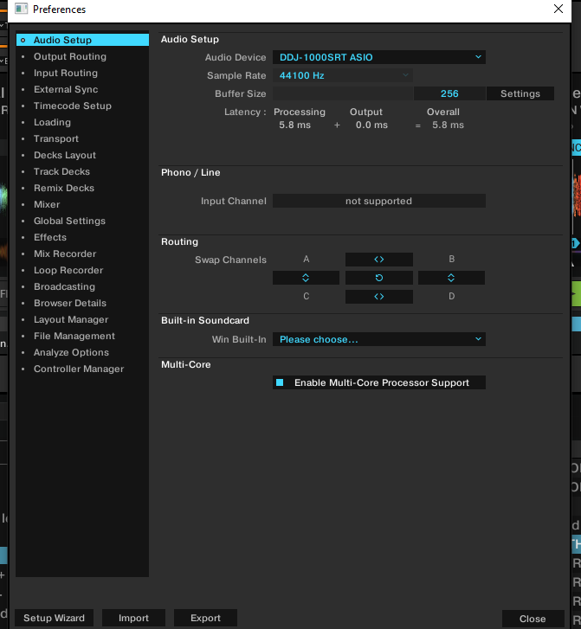
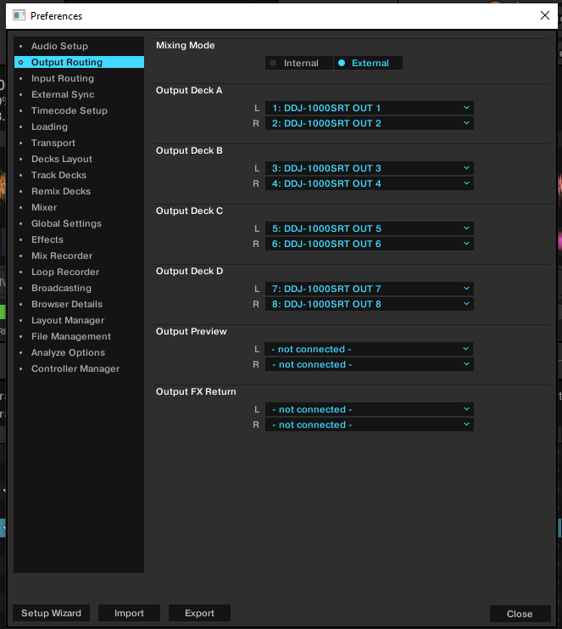

Slide 3
